Slide 1

Funding In Startups
Startups often rely on external funding to fuel their growth and innovation. This presentation will explore the various aspects of startup funding, from the distribution of funding across categories to the historical trends and recommendations for stakeholders.

Slide 2

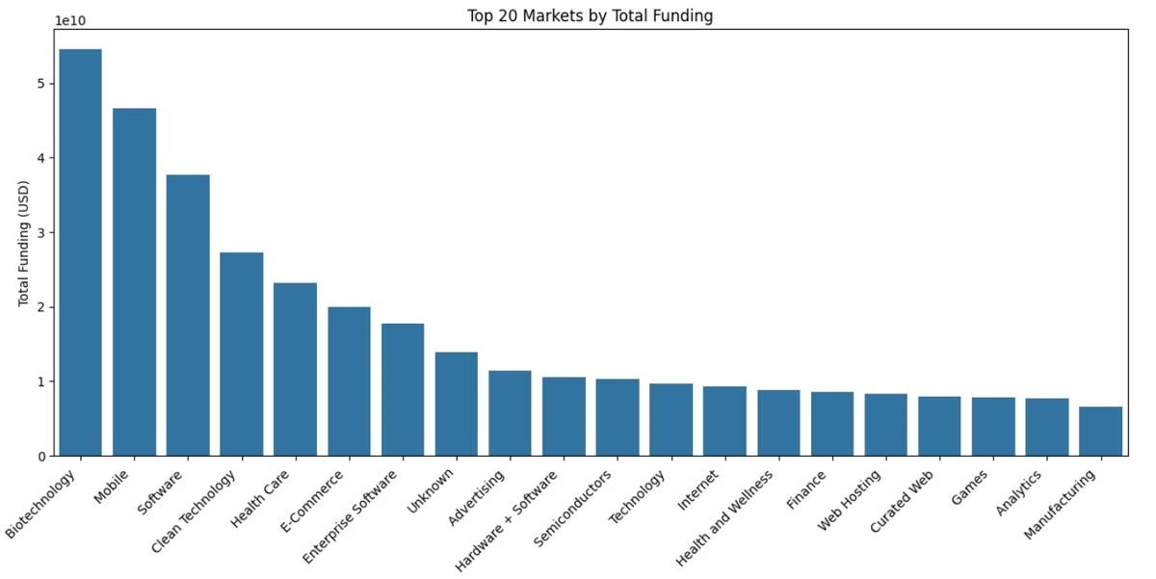
Top-Funded Markets
Biotechnology
Emerging Sectors
Substantial funding in these technology-intensive markets, reflecting their growth potential.
Clean Technology, Health Care, and E-commerce also receive significant funding, indicating diversifying investor interests.
Mobile and Software
Leads with nearly $50 billion in funding, showcasing investor confidence in innovation-driven sectors.

Slide 3

Funding Hubs
1
SF Bay Area
Dominates with over $120 billion in total funding, cementing its status as a global tech and startup hub.
2
New York City
Follows with over $60 billion, reflecting its strength in finance and growing tech sectors.
3
Global Presence
Major international cities like London, Beijing, and Shanghai also rank high, showcasing the global nature of startup ecosystems.

Slide 4

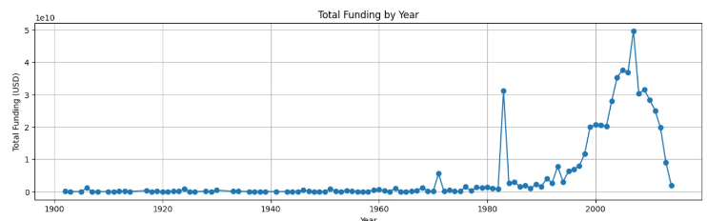
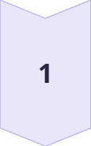
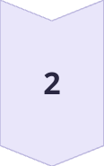
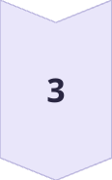
Funding Trends Over Time
Pre-1980s
Minimal funding activity, indicating the lack of formalized startup financing.
Late 1990s to Early 2000s
Significant spike in funding, aligning with the dot-com boom era.
Post-2010
Another rise in funding, followed by a drop-off, reflecting economic cycles.

Slide 5

Top Funded Categories
Biotechnology
Leads with over $50 billion in funding, showcasing investor interest in this sector.
Mobile and Software
Receive substantial funding, around $45 billion and $25 billion respectively.
Emerging Sectors
Clean Technology and E-commerce also attract significant funding, around $25 billion each.
Lower-Funded Areas
Semiconductors have the lowest funding, under $10 billion, among the top categories.

Slide 6





Top Startup Hubs by Count
Software
Dominates with over 3,500 startups, the highest among the top 10 categories.
Biotechnology
Ranks second in startup count, reflecting its strong funding position.
Mobile
Maintains a moderate startup presence, indicating a competitive landscape.
E-Commerce
Also has a mid-level startup count, showcasing ongoing innovation in this sector.

Slide 7
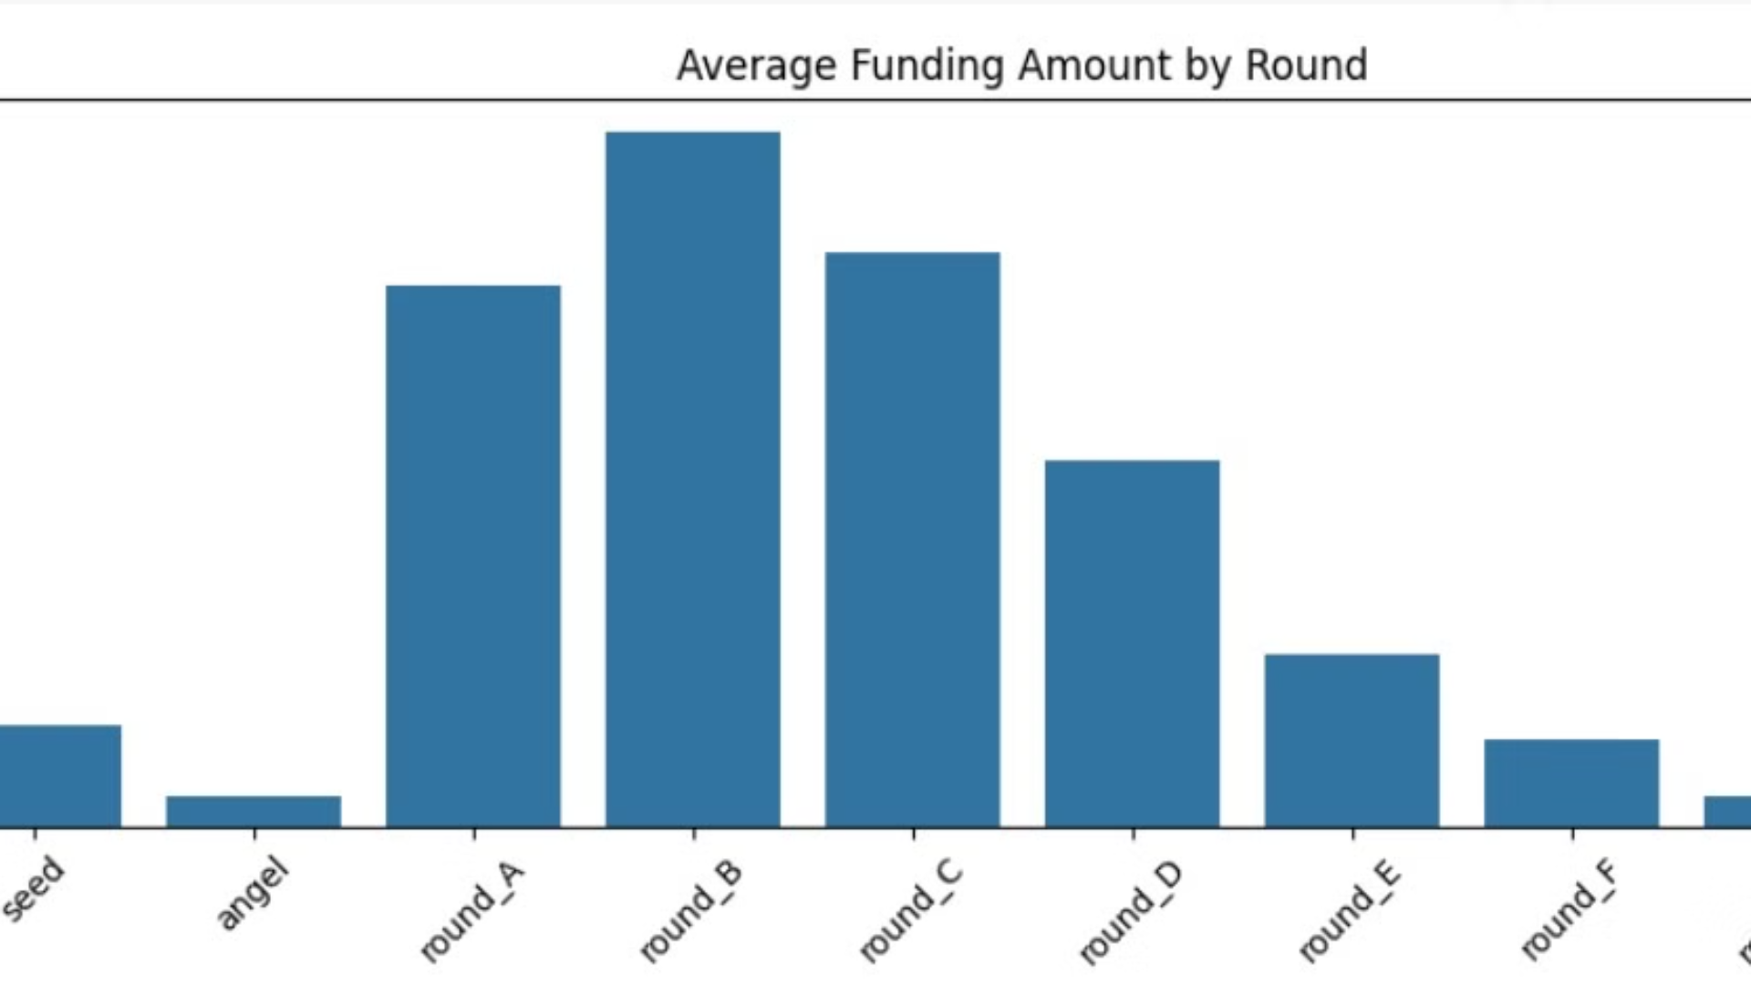
Funding Round Dynamics
1
Round B
Highest average funding, over $1.6 million, indicating significant investment in growth-stage startups.
2
Rounds A and C
Also have substantial funding, around $1.4 million and $1.2 million respectively.
3
Later Rounds
Funding decreases notably after Round C, with Round D averaging around $700,000.

Slide 8
Funding Sources
Venture Funding
Private Equity
Debt Financing
Dominates the landscape, surpassing $300 billion, reflecting investor preference for high-risk, high-reward opportunities.
Second-largest funding source, around $100 billion, indicating the role of institutional investors.
Moderate funding, suggesting the importance of leveraging debt alongside equity for startups.

Slide 9
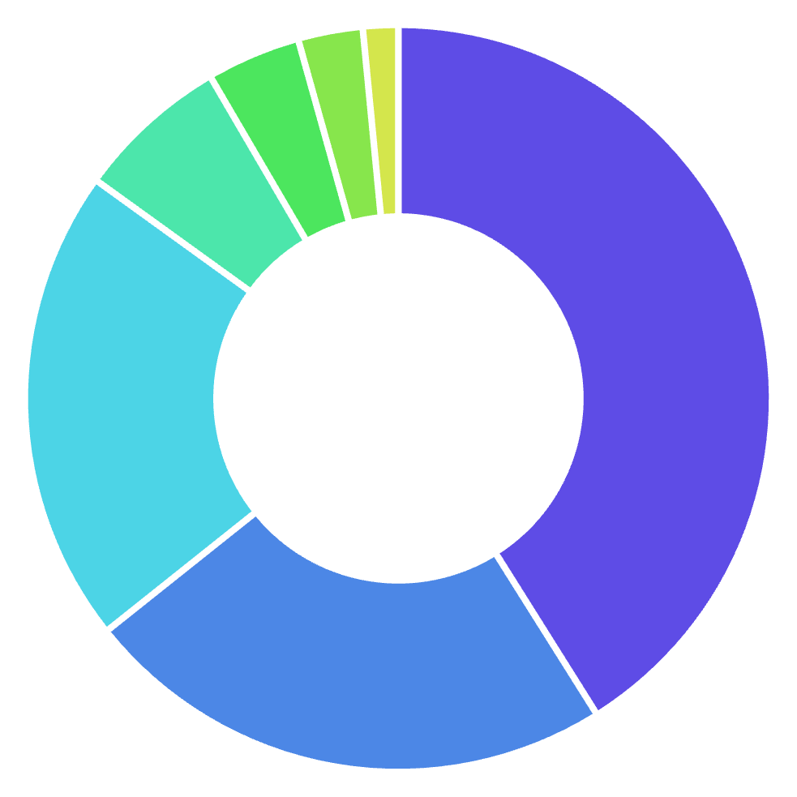
Distribution of Funding Sources
Venture
Private Equity
Debt Financing
Post_IPO_Equity
Seed
Grant
Angel

Slide 10
Key Insights
Top sectors:
Biotechnology, Mobile, and Software receive the most funding.
Geographic concentration:
Major tech hubs, especially SF Bay Area and NYC, dominate funding.
Funding rounds:
Higher amounts are secured in early funding rounds, but fewer companies progress to later stages.

Slide 11

Recommendations
1
Market Concentration:
Focus on high-potential sectors like Biotechnology, Mobile, and Software to align with investor interests.
2
Geographical Disparity
Consider relocating to major tech hubs to increase access to funding opportunities.
3
Funding Dynamics
Plan for a strategic mix of funding types, including debt financing, to maximize total funding potential.
4
Outlier Effect
Prepare for potential decreases in funding availability in later rounds and plan accordingly.

Slide 12

Conclusion
The startup funding landscape is dynamic and concentrated in specific sectors and regions
Success in securing funding often correlates with strategic choices in location, sector, and funding mix
Data-driven decision-making is crucial for navigating the complexities of the startup ecosystem
By leveraging these insights, stakeholders can make more informed decisions to foster innovation and growth in the startup world

